Slide 1


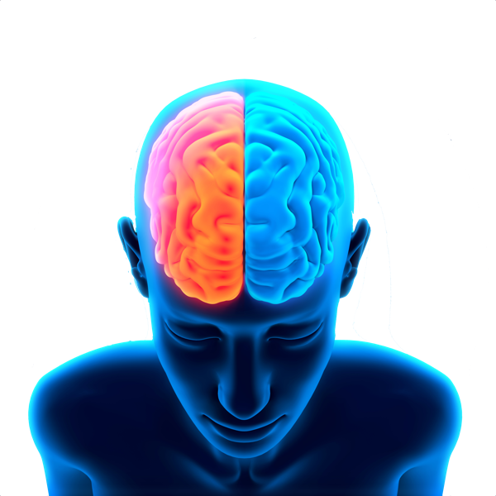
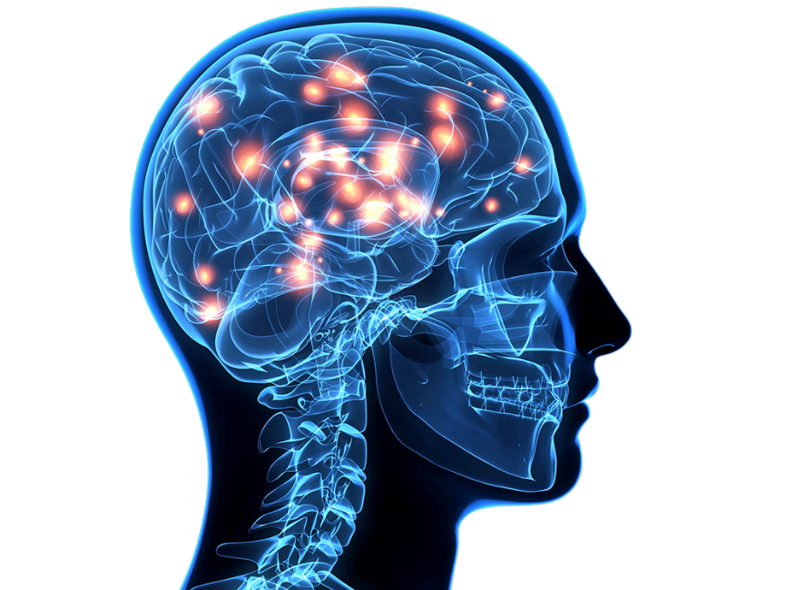
Security Aspects of neuromorphic systems
Instituto Politécnico Nacional
Centro de Investigación en Computación
Francisco Ventura Blancas
Profesor: Dr. Ricardo Barron Fernandez

Slide 2
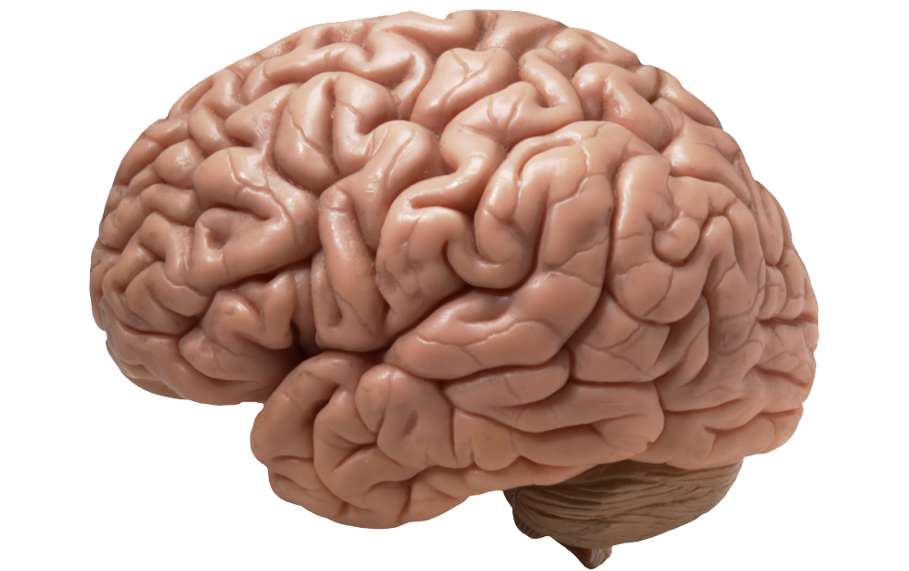
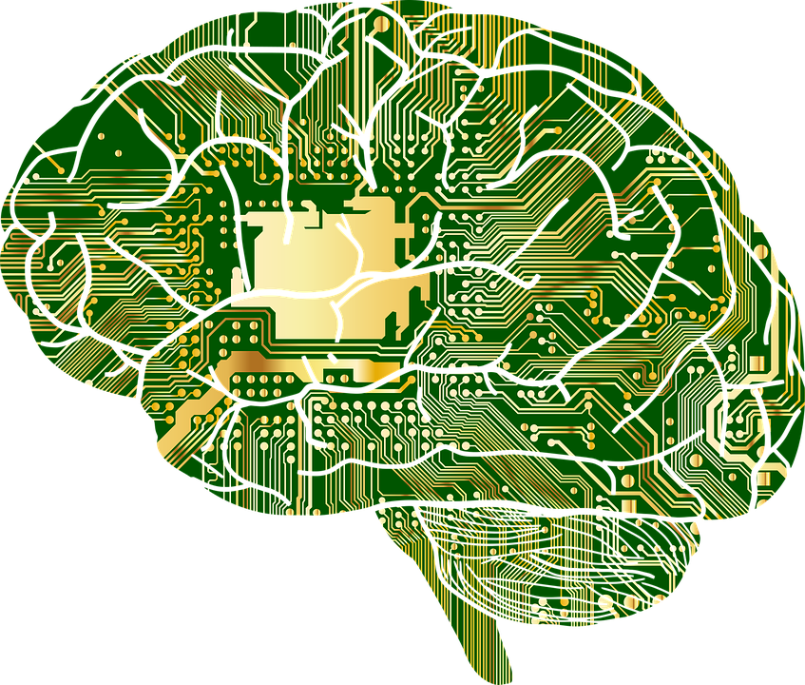
Contents
Definition
Brain Research MIT
AI Historical context
Travel from human size to
neurotransmitters in 90 seconds
Security Goals
A System on Chip (SoC)
Neuromorphic Security
Cryptography
Software Security with Hardware in Mind
Firmware Protection
Security of Emerging Memory Chips
Security of Analog, Mixed-Signal,
and RF Devices
Application of Optical Techniques to
Security Threat and Hardware
Assurance
Computer Vision for Hardware Security
Asynchronous Circuits and Their
Applications to Hardware Security
Microfluidic Device Securit

Slide 3
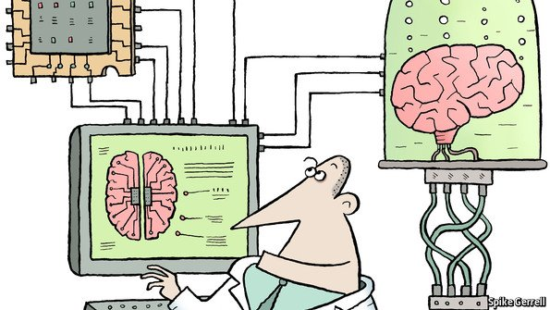
definition
Neuromorphic engineering, also known as neuromorphic computing, is the use of very-large-scale integration (VLSI) systems containing electronic analog circuits to mimic neuro-biological architectures present in the nervous system

Slide 4

Introduction

Slide 5


Slide 6
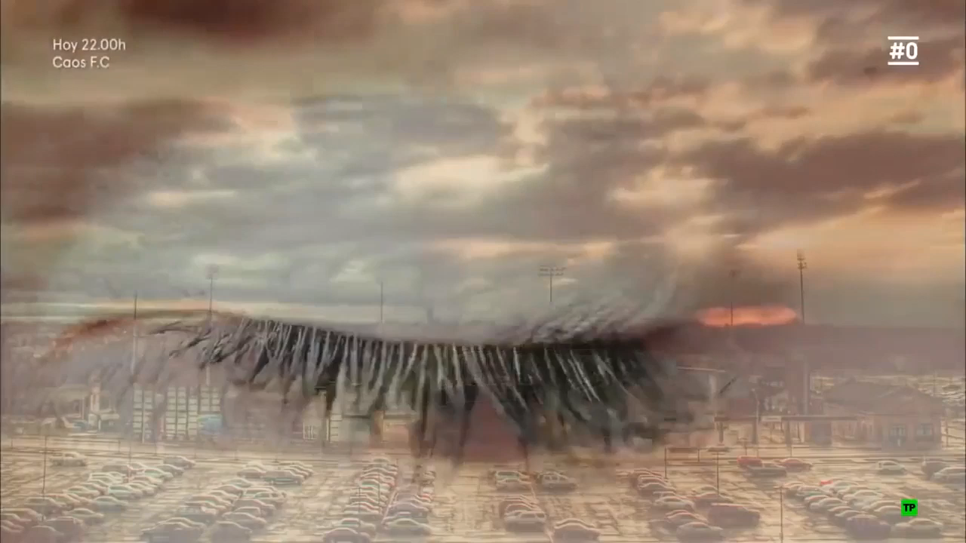

Slide 7
AI in historical context
1940s: Alan Turing first proposes “braininspired” machine intelligence
1950s: Frank Rosenblatt (Cornell) proposes “perceptron” neuron model
1960s: Marvin Minsky (MIT) argues for multi-layer (feedforward) network
1970s: AI winter
1980s: resurgence
1990s: Carver Mead (Caltech) pioneers “neuromorphic engineering”

Slide 8
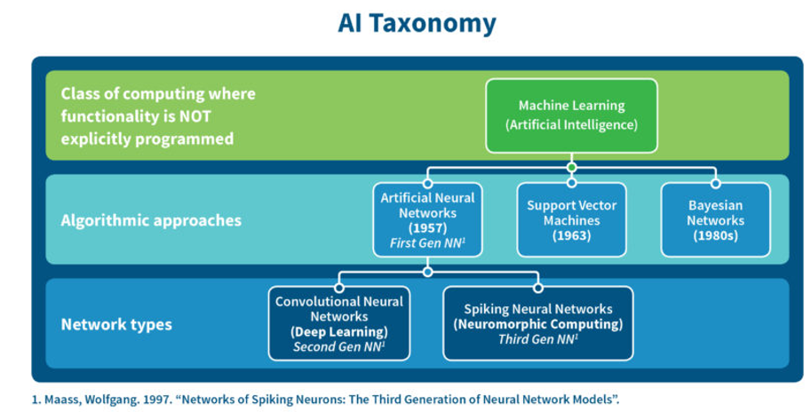
AI Taxonomy

Slide 9
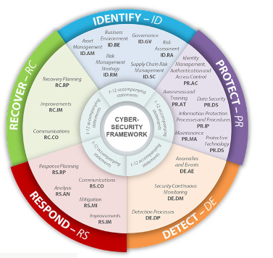
Control security
A control consists of an action, mechanism, device or technique that mitigates, removes or reduces a vulnerability to reduce risks
Prevention
Detection
Mitigation
Recovery Transfer
Preventive firewall controls controls
IDS intructions detection system
IPS instruction protection system

Slide 10

Security goals

Slide 11
Introduction
Cryptology
cryptography
Steganography
Cryptanalysis
Steganalysis

Slide 12
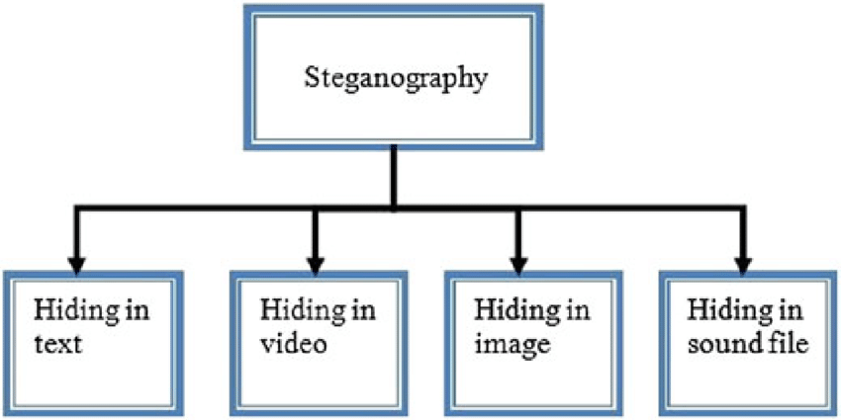

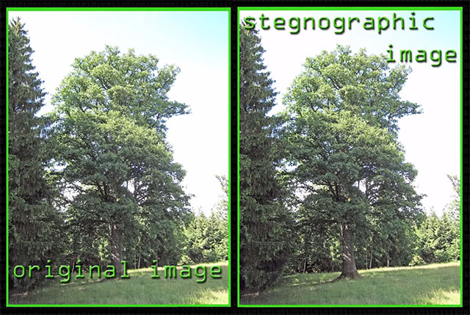
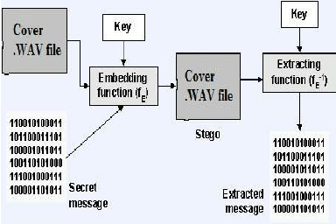

Slide 13



software
Xiao Steganography is free software that can be used to hide secret files in BMP images or WAV files
It also supports encryption. You can select from various algorithms like RC4, Triple DES, DES, Triple DES 112, RC2 and hashing SHA, MD4, MD2 and MD5

Slide 14
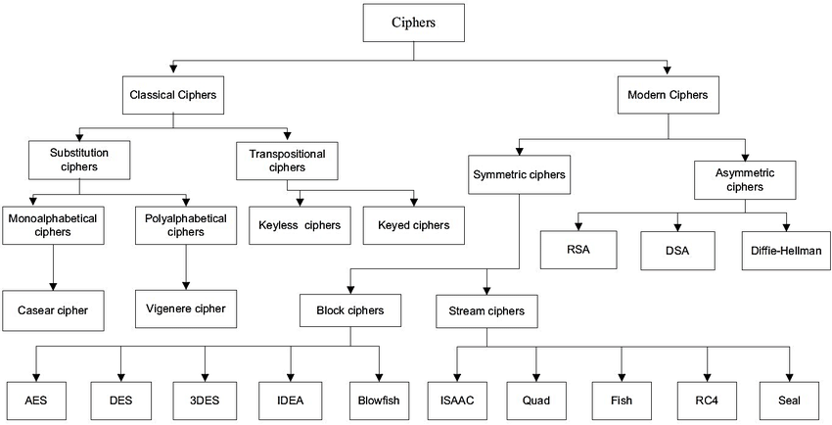
Cryptography Ciphers

Slide 15


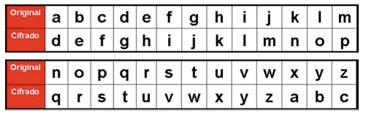
introduction
When Julius Caesar sent messages to his generals, he didn't trust his messengers. so
he replaced every A in his messages with a D.

Slide 16



Historical evolution
Key of sector such as:
Banking
ATMs, wire transfers, electronic banking...
Communication Network
VPNs security email
E-Commerce
Mobile Phones
Pay TV and satellite TV
Digital Rights Management(DRM)...

Slide 17
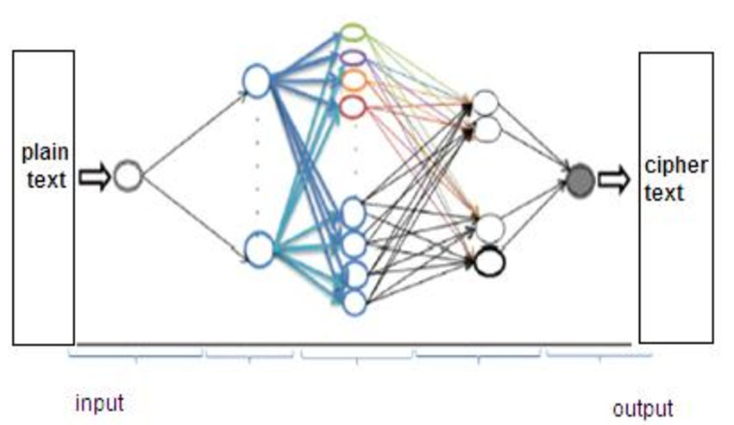
Neural cryptography is a branch of cryptography dedicated to the analysis of the application of stochastic algorithms, especially artificial neural network algorithms, for their use in encryption and cryptanalysis
What is Neuronal Cryptography?

Slide 18

Neuromorphic computing algorithms
The applications of neural networks to cryptography, and computer security in general, can be divided into the following categories:
● Resolution of AI related problems.
● Design assistance.
● Cryptanalysis.
● Evaluation of cryptographic algorithms.
● Authentication.
● Public Key Algorithms.
● Symmetric algorithms.
● Pseudorandom Number Generators

Slide 19
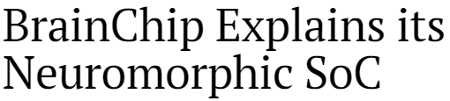
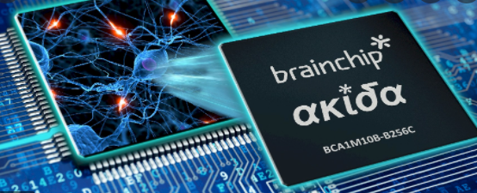
What is SoC?
A System on Chip (SoC) refers to a single-integrated circuit (chip) composed of all the components of an electronic system.
The small and efficient Akida NSoC is ideal for edge applications such as advanced driver assistance systems (ADAS), autonomous vehicles, drones, vision-guided robotics, surveillance, and machine vision systems.

Slide 20
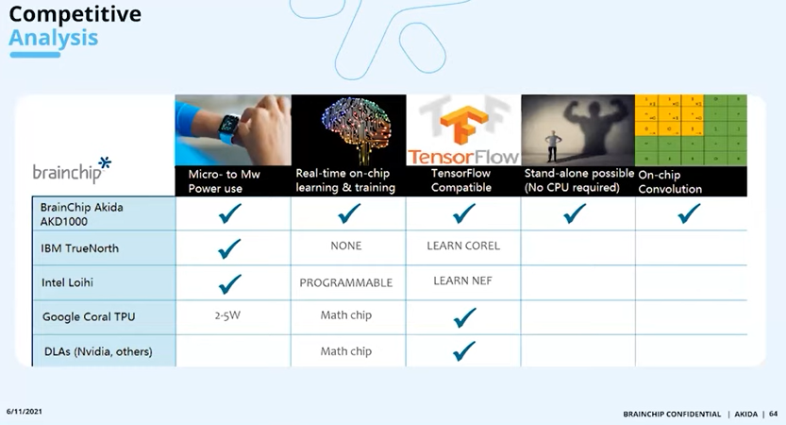
AKIDA CHIP

Slide 21

Security is important

Slide 22
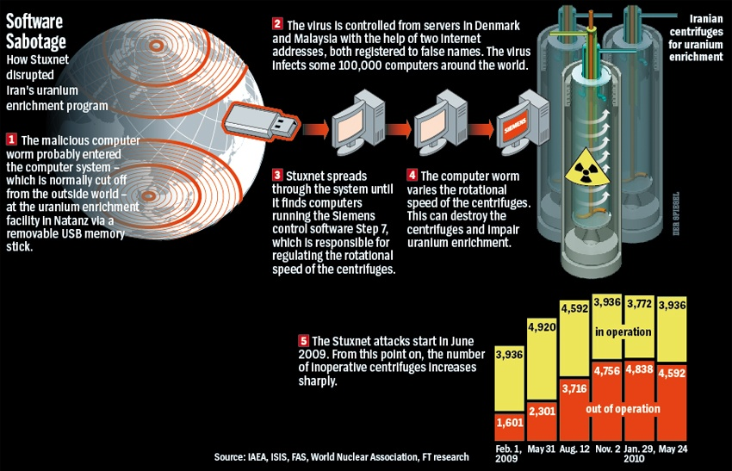
Security is important

Slide 23
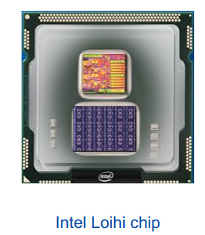
Neuromorphic computing chip could ‘smell’ explosives, narcotics, and diseases
test chip designed by Intel Labs that uses an asynchronous spiking neural network (SNN) to implement adaptive self-modifying event-driven fine-grained parallel computations used to implement learning and inference with high efficienc

Slide 24
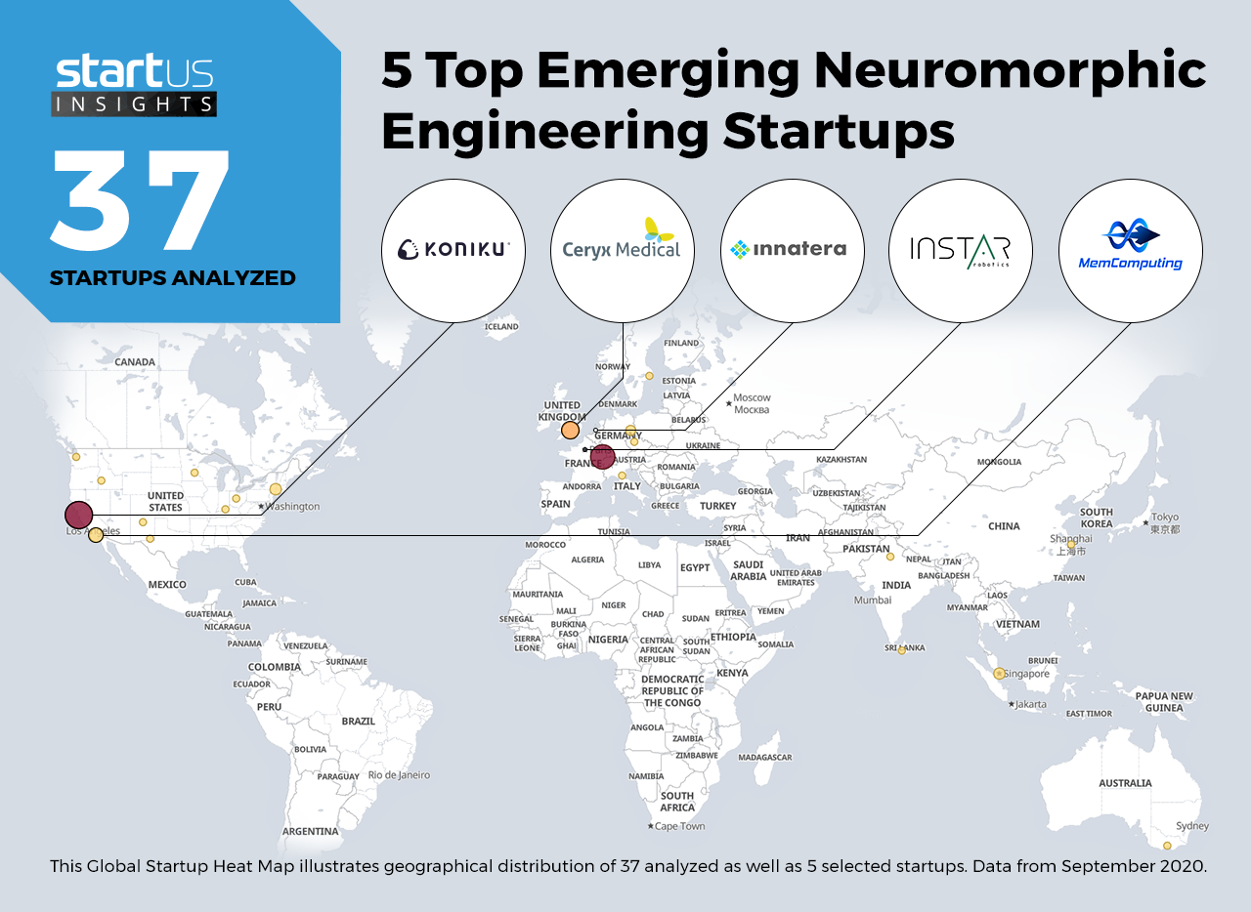

Slide 25
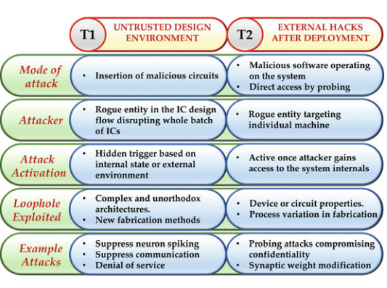
Threat Models
Security threats can be broadly classified into two lateral threat models based on
the source of security vulnerability

Slide 26
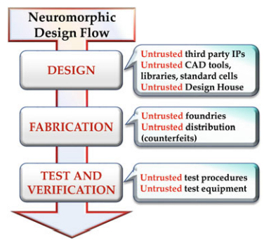
Neuromorphic Desing Flow
Neuromorphic
design flow illustrating
opportunities for hardware
Trojan insertion
Research in many of these areas for neuromorphic computing is at a very nascent stage, but the pressure to cater to a growing number of critical applications
may force premature adoption of neuromorphic systems

Slide 27
TBD
There is an imminent need for research
on security properties, models, and standards for mindful implementation of bioinspired hardware models.

